Slide 1
Minds, Machines, Persons
The nature of representation

Slide 2
Overview
What is a representation?
How is representation possible?

Slide 3
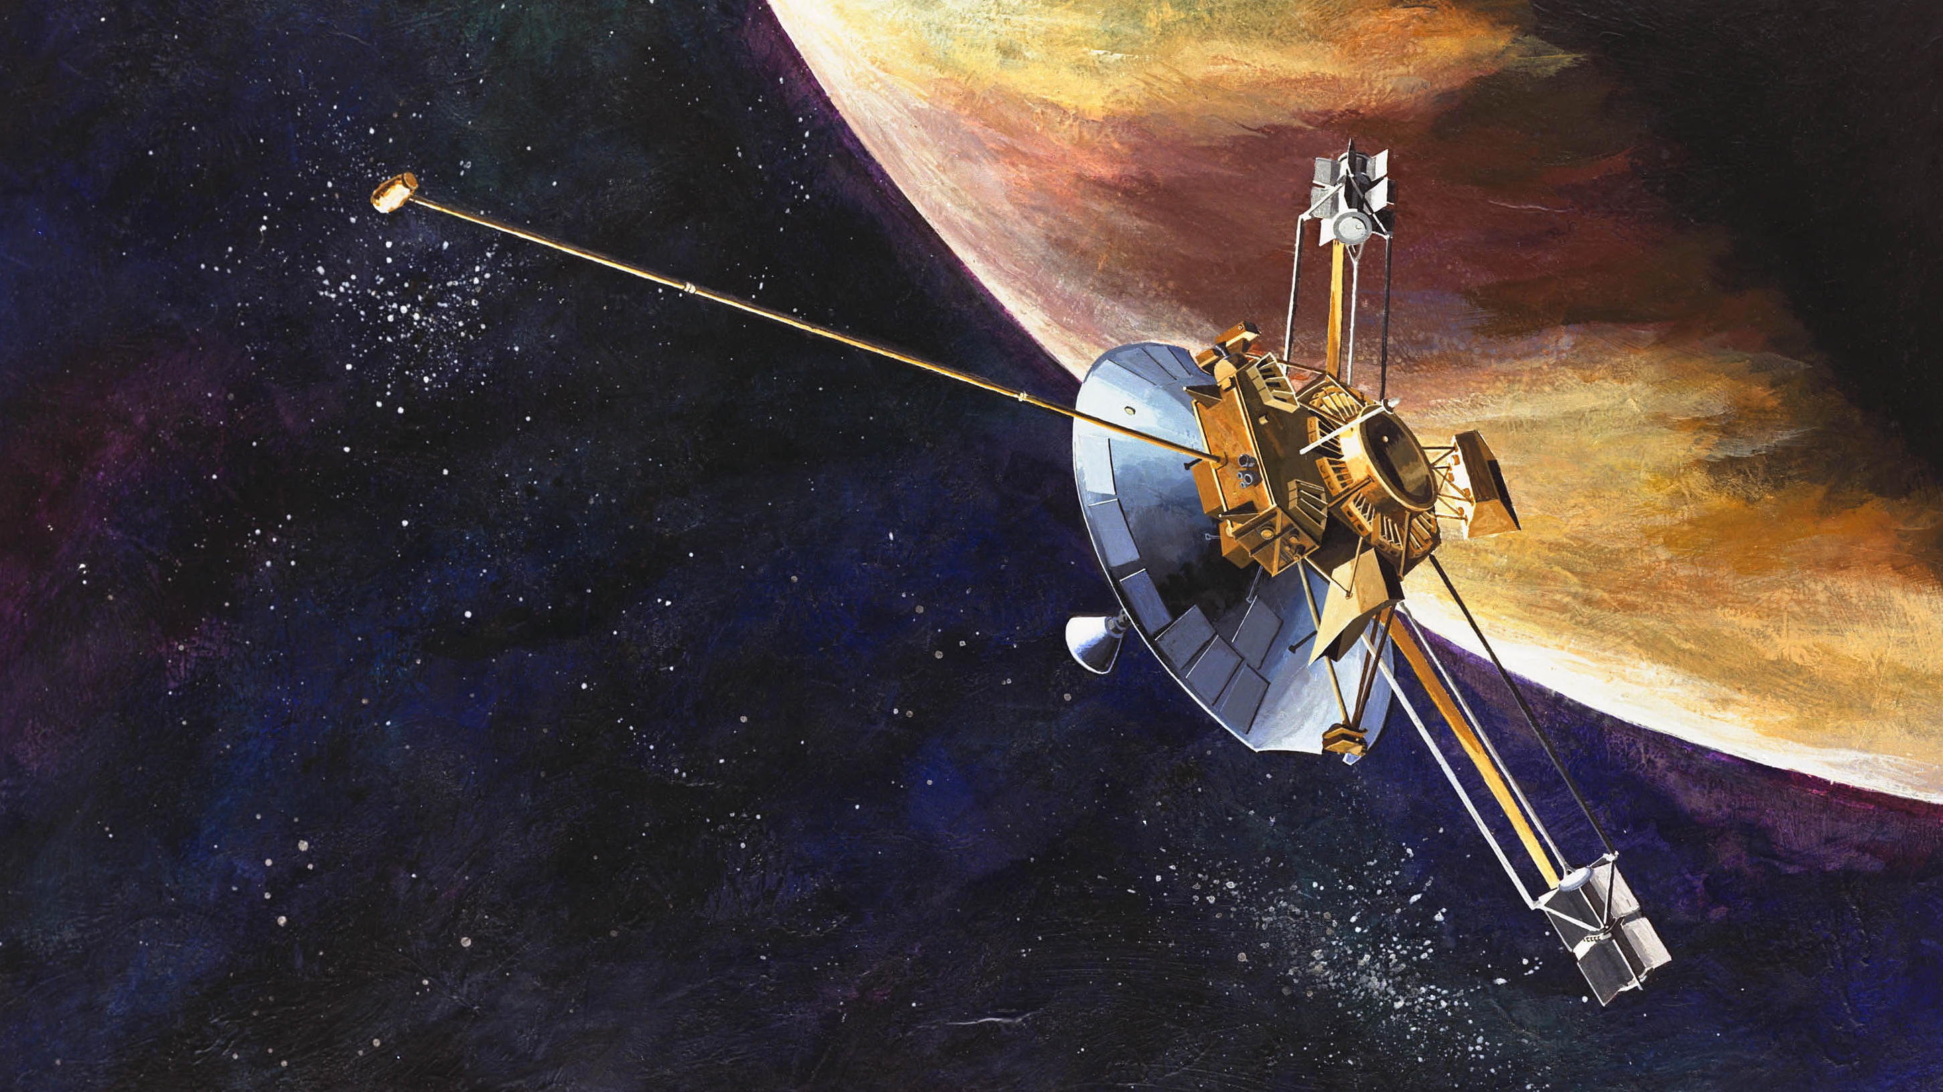
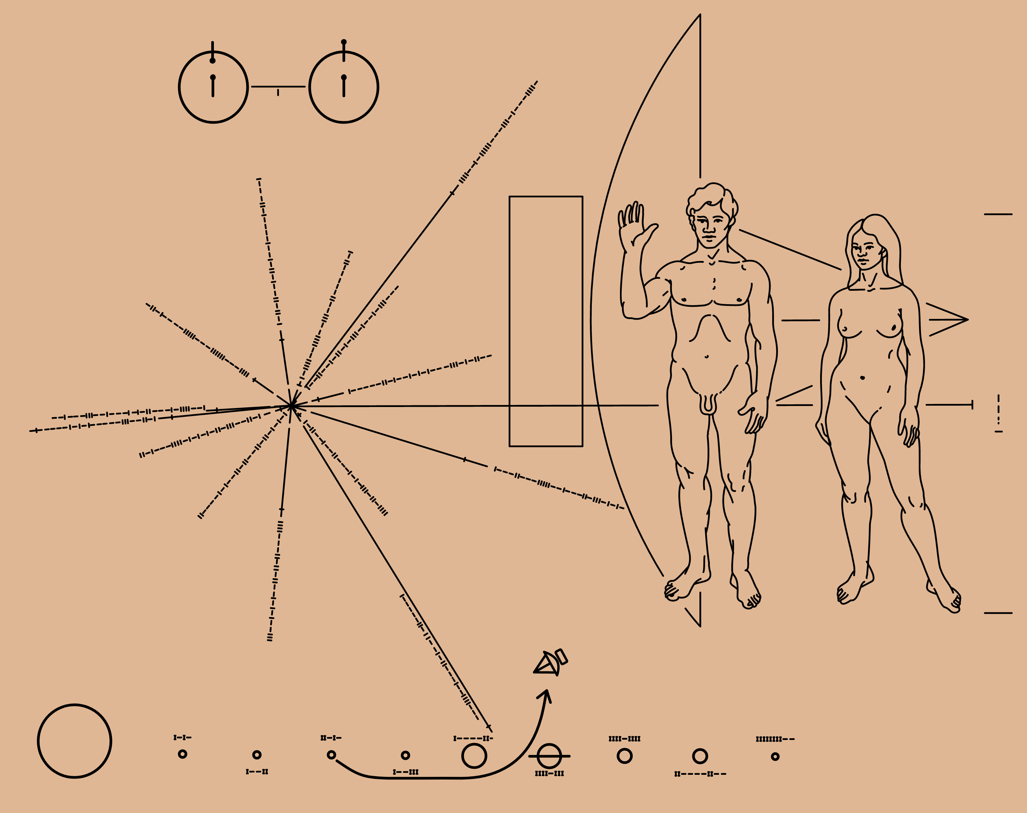
The puzzle of representation
In 1972, NASA sent a space probe containing a metal plate engraved with pictures and signs
Each set of markings represents something about us
Diagram: represents a hydrogen atom
Picture: Naked man and woman with raised hands
The raised hands represent the message “we come in peace”
They mean something to us, but there is nothing in the marks themselves that tell an extraterrestrial how to understand them
“Each sign by itself seems dead; what gives it life?”-Wittgenstein

Slide 4
Representation: philosophical issues
What is the nature of a representation?
Can a satisfactory definition be provided?
What sorts of things can be representations?
How do representations represent?
Are some forms of representation more fundamental than others?
Is there a basic form of representation?

Slide 5
Defining ‘representation’
Crane: something that represents something
Relation between two things
Godfrey-Smith: something that (typically) stands for something else
Function: used as a guide for dealing with something else (e.g. a map)
What are some things that represent?
Paintings
Numerals
Tree rings
A piece of music
Data structures
Vervet Monkey call
The human mind
Historical figures
Abstract objects
Age
Anger
Text or images
Eagle (or large predatory bird)
Nonexistent entities
can represent
Notes:
We can raise all sorts of interesting questions about each form of representation.
How does a piece of music represent human emotions or anger?
How does a picture represent a historical figure?
How does the human mind represent such a wide range of things?
We are going to focus mainly on this last question. Crane argues, quite convincingly, that an understanding of mental representation is the key to understanding all of the other forms. He discusses some theories about specific forms of representation (theories about pictorial representation), and why they are inadequate. But we won’t discuss those issues here.

Slide 6
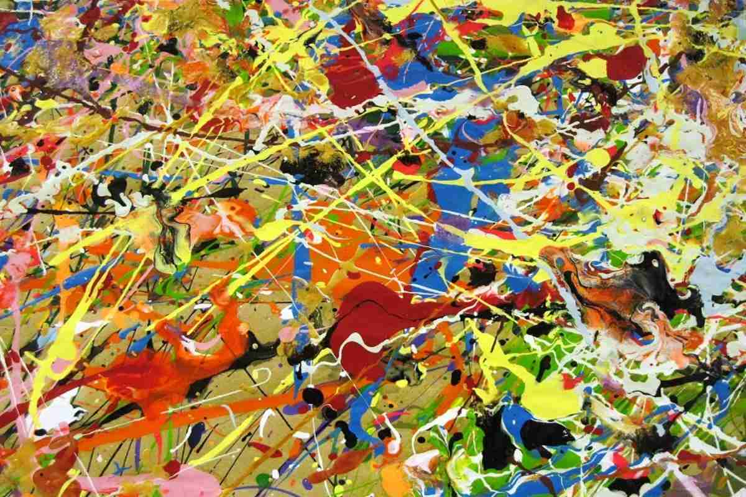
Things that don’t represent
Grains of sand
Volcanos
Stomach acid
Random collections of objects
Complication: Humans and nonhumans might use some of these things to represent something
Form of communication or art
Interesting case: Abstract art
The objects don’t represent anything, by themselves

Slide 7
Types of representations
Pictorial representation: something that is represented in a picture
Linguistic representation: something that is represented by words or symbols
Mental representation: something that is represented by thoughts
Illustration: Cookie recipe
A series of photos
Recipe book (no pictures)
Grandma’s head

Slide 8
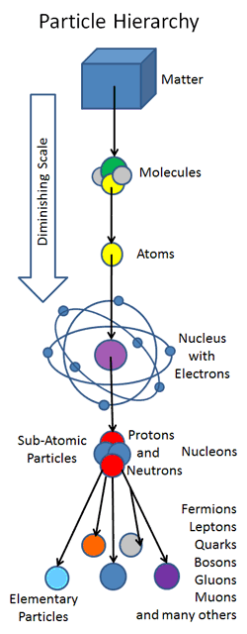
The fundamentality of mental reps.
Crane believes that mental representations are fundamental
What do we mean when we say mental representations are fundamental?
An analogy: Physics
So, the claim is that representation bottoms out in the mind
Dependency: If you were to eliminate all minds, there would be no representations
Explanation: All representations can be explained in terms
of mental representations
The mind is what ultimately has the power to represent
Why does Crane believe this?
Process of elimination (pictures and words cannot do the job)

Slide 9

Why pictorial representations aren’t basic
The central problem: Pictures are lacking in representational power
They cannot represent certain things that words and sentences can
Words and symbols can represent the following state of affairs; pictures cannot
“If it doesn’t rain this afternoon, we will go for a walk”
How can we draw pictures of logical connectives (·, ∨, ~, ⊃)?
What might be some other examples of things we can represent in language but not in pictures?
Support: Games that involve drawing can be very difficult
Much easier if we could include words or symbols

Slide 10
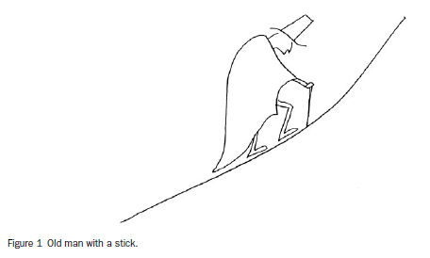
Additional problems
What is it a picture of? What does the picture represent?
Pictures do not interpret themselves
In order to know what a picture represents, an agent needs to do some interpreting
So, pictorial representations require an interpreter or agent

Slide 11
Why linguistic representations aren’t basic
Where do words and sentences get their meanings?
How do they represent?
Social conventions: we’ve collectively decided that ‘dog’ stands for dog
Problem: This doesn’t explain representation
Takes for granted that humans have the ability to represent, and that we’ve collectively decided that a string of symbols stands for dog
Mental representations: Words represent our thoughts
Philosophers like Locke and Hume argued that ALL of our thoughts take the form of pictures
Hume: All of our thoughts are faint copies of perceptions, combinations of those copies
Father of psychology/cognitive science

Slide 12
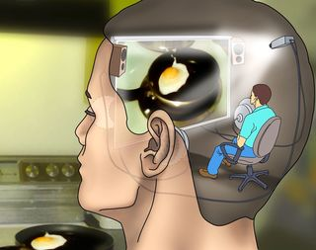
Mental representation: philosophical issues
Early accounts of mental representation are unsatisfactory
Philosophers like Locke and Hume argued that ALL of our thoughts take the form of pictures
Hume: All of our thoughts are faint copies of perceptions, combinations of those copies
Problem 1: Is our thought of a dog a mental image of a particular dog (Fido)?
If yes, then wouldn’t that just be a representation of Fido?
If not, what is it an image of? (an image of dogness?)
Problem 2: We’ve already established that pictures aren’t capable of representing everything that can be thought about
Problem 3: How can there be pictures without an agent interpreting them?
A tiny picture viewer (in the head)
Homunculus problem
Notes:
Possible empirical objections to picture theory: there are individuals (2-5% of the population) who can think but not in pictures or any kind of mental imagery (some don’t even have dreams). They can only think in words. congenital aphantasia

Slide 13
How the mind represents
The picture theory of thoughts (Locke, Hume) is an unsatisfactory account of what mental representations are like
Theory about the format of mental representations
Alternative views: mental representations are more like language
Language of thought hypothesis (historically old)
Mental representations are more like maps
Influential view for explaining navigation
Which is the correct view? Could they all be right (pluralism)?
Unlikely that ALL mental states have the same format
Pluralism is a plausible view and accepted by many cognitive scientists
Depends on the kind of mental representation you’re talking about

Slide 14
‘Mental representation’ in psychology
Many early psychologists and philosophers were deeply bothered by the philosophical issues surrounding mental representation
Mental representations thought of as spooky or unscientific
Much like Newton’s proposal that gravity involves “action at a distance”
Some neuroscientists still have this reaction today
The behaviorist turn in psychology (Early-mid 20th century)
We should eliminate talk of internal representations
No place for such entities in science
Focus on what we can study: external acts of behavior
Mid-20th century: Mental representation starts to make a comeback
Representations become acceptable in science after new empirical findings

Slide 15
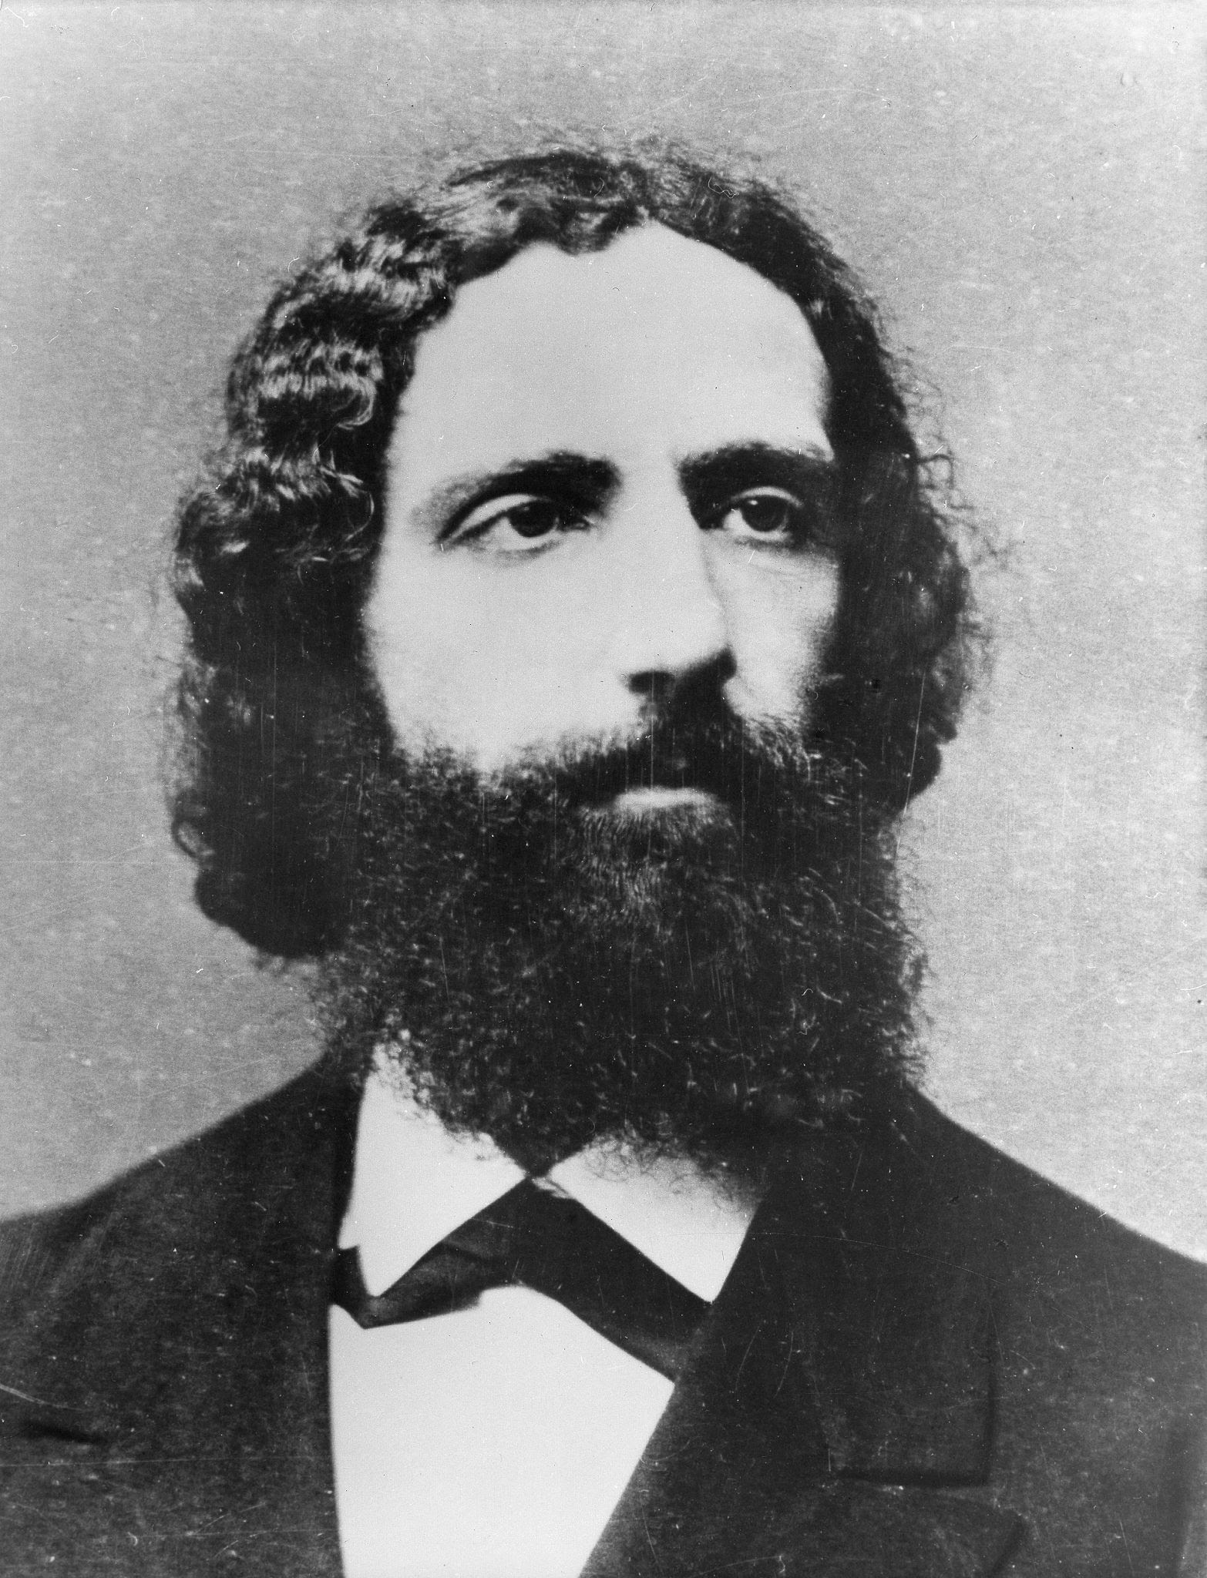
Next time
Brentano and intentionality
A special kind of representational power that only occur in minds
A proposal for the mark of the mental

Slide 16
Homework
Crane Ch. 3

